Slide 1

Product Market Fit Analysis
Created by – Priyanshu Prakash

Slide 2
Overview
Project Name: Conduct Market Fit Research for Air Purifier Development Using AQI Analytics
Domain: Consumer Appliances
Function: Market Research Analytics
Company: Air Pure Innovations – a startup addressing India’s air quality crisis.
Goal: Use data and analytics to assess market potential for air purifiers and guide product strategy.

Slide 3
Problem Statement
India has 14 cities among the world’s top 20 most polluted.
Air Pure Innovations wants to know if there is sustained demand for air purifiers before investing in production & R&D.
They need to identify:
Key pollutants to target.
Must-have product features.
Cities with highest demand & market size.
How to align R&D with localized pollution patterns.
Real-world urgency:
Example: Bryan Johnson leaving a podcast due to poor air quality.
Taj Hotels in Delhi displaying live AQI readings for guests.

Slide 4
Objectives
1. Severity Mapping – Identify cities with persistent/worsening AQI.
2.Health Impact Correlation – Measure how pollution affects health outcomes.
3. Demand Triggers – Check how pollution spikes impact consumer interest in air purifiers.
4. Deliver a Market Prioritization Dashboard for top management and product teams.
5. Provide a Product Requirements Document with must-have features and pricing tiers.

Slide 5
Dataset Overview
We will use four key datasets from the Dataful platform and other research:
1. Day-wise AQI Data – Daily air quality values, pollutants, and status for Indian cities/towns (2022–2025).
2. Health Outcomes Data – Weekly state/district-wise reported cases & deaths from pollution-related illnesses(2022–2025).
3. Vehicle Registration Data – Monthly state-wise data by vehicle type and fuel type, including EV adoption rates.
4. Population Projection Data – Projected state-level populations (Total, Male, Female).

Slide 6
Primary Analysis
1. Identify top & bottom 5 areas with highest avg AQI (last 6 months).
2. Find top & bottom 2 pollutants per southern Indian state (2022 onwards).
3. Compare AQI on weekends vs weekdays in 8 metro cities (last 1 year).
4. Find worst air quality months for top 10 states.
5. For Bengaluru, count days in each AQI category (Mar–May 2025).
6. Top 2 diseases per state + corresponding avg AQI (last 3 years).
7. Compare AQI in top EV adoption states vs low-EV states.

Slide 7
Secondary Analysis
1. Identify age groups most affected by air pollution (by city).
2. Analyze major competitors & their unique features (pricing, tech, design).
3. Compare city population size vs AQI to see if bigger cities are always more polluted.
4. Assess public awareness of AQI & its health effects.
5. Evaluate government pollution-control policies in the last 5 years and their effectiveness.

Slide 8
Key Insights from Primary & Secondary Analysis
1. Common demographics – Most admissions are from middle-aged males with blood type O+.
2. Top medical conditions – Hypertension and diabetes are most diagnosed, affecting older adults more.
3. Length of stay – Cardiac cases have the longest stays, with emergencies averaging more days.
4. Treatment cost – Cancer treatments are highest in cost, with private hospitals charging more.
5. Hospital performance – Metro hospitals treat the most patients and have better test outcomes.
6. Top medications – Paracetamol and amoxicillin are most prescribed, used across all hospitals.
7. Admission types – Majority are emergency admissions, leading to higher cost and longer stays.
8. Insurance coverage – National Insurance covers most patients but has higher treatment costs.
9. Regional differences – Northern hospitals see more respiratory cases, southern more cardiac.

Slide 9
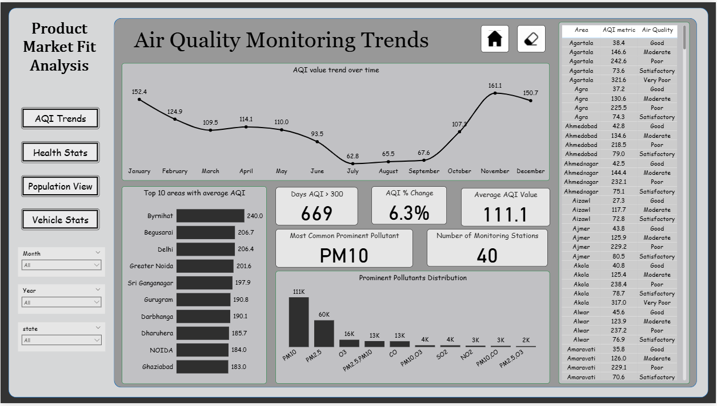

Slide 10
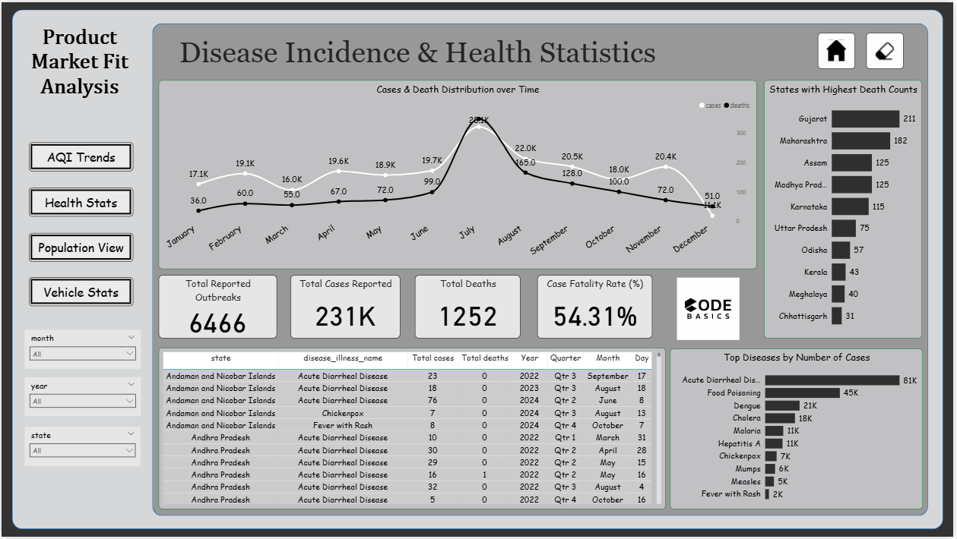

Slide 11
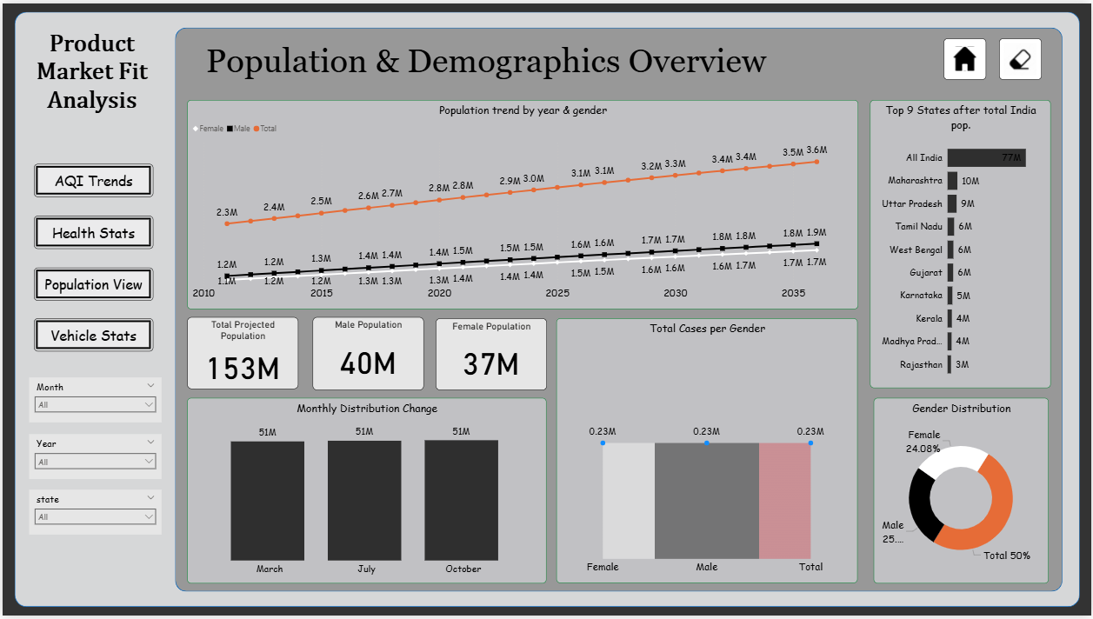

Slide 12
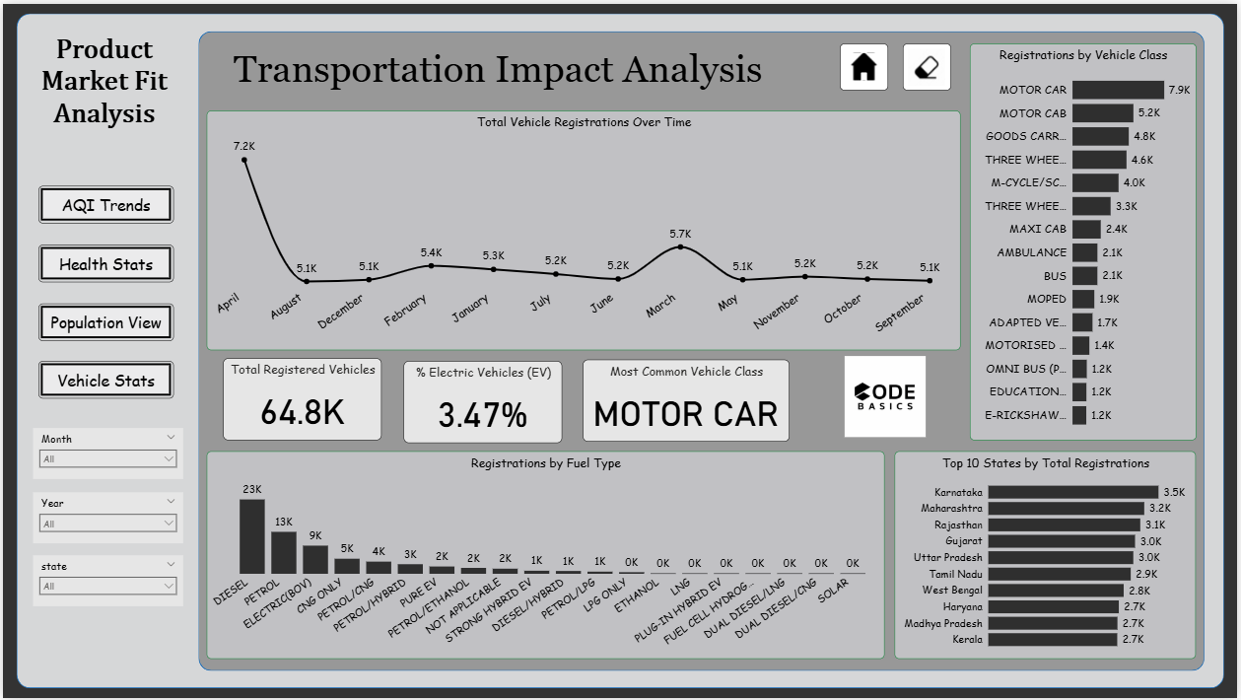

Slide 13
INSIGHTS
Seasonality & purchase timing
AQI is strongly seasonal; winter months (Nov–Jan) are worst. Demand for purifiers will peak before and during this period.
Main pollutant driver
PM10 is the most common prominent pollutant (largest counts), with PM2.5 second. Product focus must target particulate removal first.
High-risk / high-opportunity geography
NCR cluster (Delhi, Greater Noida, Noida, Gurugram, Ghaziabad) plus towns like Begusarai & Byrnihat show highest avg AQI → these are priority markets.
Some smaller towns with high AQI represent “white-space” markets with less competition.
Health burden & marketing messaging
Health data shows high counts of acute diarrheal disease & food poisoning overall, but respiratory health burden and pediatric admissions correlate with AQI spikes in many cities — strong health messaging (children/elderly protection) will resonate.
Vehicle / EV story
EV share is still low (~3.5% aggregate). EV uptake is not yet high enough to be a strong AQI improvement lever nationwide; city-level EV leadership will benefit long term but does not reduce immediate purifier demand.
Competitor gaps (product feature gaps)
Market needs: real-time indoor/outdoor AQI sync, compact and portable models for small urban homes, low-maintenance filters, and energy-efficient operation. Some competitors lack native AQI sync and good app UX.

Slide 14
Recommendations
Highlight Key Delay Factors – Focus on weather, carrier, and origin/destination patterns.
Show Seasonal Trends – Compare delays by month/season to find peak problem periods.
Prioritize High-Impact Routes – Identify routes with the most delay minutes to target improvements.
Segment by Flight Type – Separate short-haul vs. long-haul for clearer insights.
Add Predictive Element – Use historical trends to forecast likely delays.
Visualize Passenger Impact – Estimate affected passengers per delay to show real-world effect.
Benchmark Airlines – Compare carriers to highlight best and worst performers.

Slide 15
